Slide 1
Agile-Scrum and Waterfall comparison
A comparative analysis of project leadership methods
Taylor Nedrow
12/15/24

Slide 2
Scrum Roles - Scrum Master
Scrum Master Responsibilities include:
The Scrum Master facilitates the Scrum process which includes
1. “Lead scrum events including sprint planning, daily scrum, sprint review and scrum retrospective” (Landau, 2018)
2. Address blockers the team faces
3. Helps guide the team in Agile methodology
Importance
Makes sure the team is working on items that align with business interest and keeps Scrum running

Slide 3
Scrum Roles - Product Owner
The product owner represents the stakeholders. Product Owner Responsibilities include:
1. Communicate with the shareholders, anyone with a vested interest in the product.
2. Defining and prioritizing the product backlog.
The team uses the product backlog to dictate what they're working on.
This role is pivotal to supplying the team with clear guidance on what is being made, the details of it, and the overall vision.
Importance
The product owner steers the ship and carriers the torch of the vision.
“They are tasked with conveying a clear vision to the Scrum team”(Salimi, 2024)

Slide 4
Scrum Roles - Tester
The tester collaborates with the team to ensure the final deliverable is functional and to vision.
Tester responsibilities include:
1. Working with the team to create clear pass/fail test cases from user stories. These are the criteria that determine whether a feature is functional.
2. Running a variety of test such as automated tests and manual tests.
3. Logging and tracking known bugs ensuring deliverables are functional.
Importance
Ensures a functional increment is delivered

Slide 5
Scrum Roles - Developer
“The people that do the work” (West, 2019)
A group of cross functional developers with a varied skill set
Responsibilities of the developer include:
Collaboration: Work closely with other team members to meet deadlines
Feature implementation: Make the product whether that be design or coding
Technical Excellence: write excellent code
Self-Management: an agile team is trusted to do their work without continuous oversight
Importance
The driving force behind delivering functional software

Slide 6
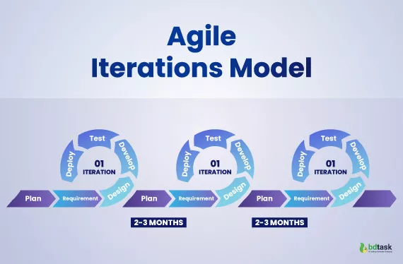
Agile Phases - Overview
There are 6 agile SDLC(Software Development Life Cycle)
Plan: communicate with shareholders to clarify vision
Requirement Analysis: analyze requirements to build user stories backlog
Design: figure out the structure of the software
Development: actually write the software
Testing: Continuously test for functionality and vision
Deployment: Release a functional increment
at the end of a sprint
This is repeated for each sprint
(Sumaiya Simran, 2023)

Slide 7
What if it were Waterfall
During the development we had to shift the vision
Originally it was general travel, it became Detox and Wellness travel
If the project had been waterfall it would been completed wrong
The project would have to be restarted to fit the new vision restarting the SDLC from the beginning
Because it was Scrum-Agile we were able to instantly change vision and deliver what the client value

Slide 8
Waterfall or Agile
Should we use the Agile or Waterfall method?
Waterfall - works for projects with clear requirements from the beginning
Less regular involvement from the client
Is more common in the industry currently
Heightens risk if vision is misunderstood
Ends when the project is complete or scrapped
Agile - works for projects that need adaptability
Requires a cultural commitment from the developer and client
Lowers risk by frequently checking vision with client i.e. the client changes vision as in the SNHU Travel project
Ends at the sprint the client choses

Slide 9
References
Landau, P. (2018, August 28). Scrum Roles: The Anatomy of a Scrum Team. ProjectManager.com. https://www.projectmanager.com/blog/scrum-roles-the-anatomy-of-a-scrum-team
Salimi, S. (2024). Understanding Key Roles in Scrum. Agile Academy. https://www.agile-academy.com/en/foundations/roles-in-scrum/
West, D. (2019). Agile Scrum Roles | Atlassian. Atlassian. https://www.atlassian.com/agile/scrum/roles
Sumaiya Simran. (2023, August 31). SDLC Agile Model-The Best Choice For Software Development. Bdtask; Bdtask. https://www.bdtask.com/blog/sdlc-agile-model

